Slide 1
Gig image
templates

Slide 2
Guidelines
Replace any “shadow image” of a person with your own personal portrait - those images are for reference only, DO NOT USE them (click image >> click Replace Image in top bar).
Feel free to change colors, size, locations and fonts of the elements to adjust the template and align it with your preferences and brand style.
You can use online background removal services to create an image with transparent background.
Download your image
Select the slide you want to save as an image, then go to File > Save As (PC) or File > Export (Mac).
Choose a location and file name, then select Save As Type and choose an image format (GIF, JPEG, PNG, TIFF, BMP, or WMF).
Save the slide then export it.

Slide 3
What’s in it for you
You Gig image is your first interaction with your future client, and some services are very hard to portray in a visual way. That’s why, we have partnered up with some Fiverr sellers to create a pool of templated Gig images that are engaging, that highlight your key value proposition and that are fully editable.
These images have been created based on some best practices such as:
Featuring yourself in the image
If adding text - it should take up no more than 20% of the image
Mentioning skills or service name
Adding a sales message

Slide 4
Terms of use
Your use of the Gig image templates (the “Templates”) is subject to Fiverr’s Terms of Service.
You may only use the Templates to create your Gig image on the Fiverr website and mobile application. Fiverr grants you a royalty-free, non-sublicensable, non-exclusive, revocable license to use the Templates solely for the purpose indicated above. For the avoidance of doubt, Fiverr retains all ownership rights to the Templates, and no ownership or copyrights are granted to you.
You remain solely responsible for the content posted in your Gig including your Gig image.
Your use of the Templates is at your own risk. The Templates are provided on an “as is” basis, without any warranty, express or implied. Fiverr makes no warranty or representation with respect to the completeness, security, reliability, quality, accuracy or availability of the Templates. Fiverr will not be liable for any claims, or incidental, consequential or other damages arising out of the Templates or your use of the Templates.

Slide 5
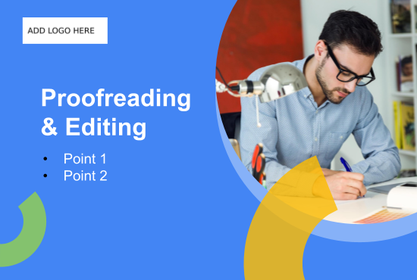

Slide 6
Created by Iamsheikhansar

Slide 7
Your logo here
SEO Services For Top Rankings
Point 1
Point 2
Point 3

Slide 8
Your logo here
Experienced social media advertiser
Point 1
Point 2
Point 3

Slide 9
Your logo here
Search Engine Marketing
(Google ads)

Slide 10
Voice Over
Artist
Point 1
Point 2
Your logo here

Slide 11
Your logo here
Tailor-made
mixing
& mastering
Point 1
Point 2

Slide 12
Your logo here
Beat Maker, Music Producer

Slide 13
Your logo here
Professional content writing
Point 1
Point 2
Point 3

Slide 14
Your logo here
Professional translations
Point 1
Point 2

Slide 15
Your logo here
Your image here
Proofreading
& Editing
Point 1
Point 2

Slide 16
Search Engine
Marketing
(Google ads)
Google Certified
Award Winner
Keyword Check
5 Yr. Experience

Slide 17
Tailor-made mixing
& mastering
Your image here
Crystal Clear Music
Bass rich Music
Transcript ready files
Rich Wav & MP3 files

Slide 18
Your logo here
Experienced
social media advertiser
Your image here
Highlight Key Feature Here
Instagram Page Handling
Facebook Page Handling

Slide 19
SEO Services
For Top
Rankings
Award Winner
Certified

Slide 20
Your logo here
Your image here
Voice
Over Artist

Slide 21
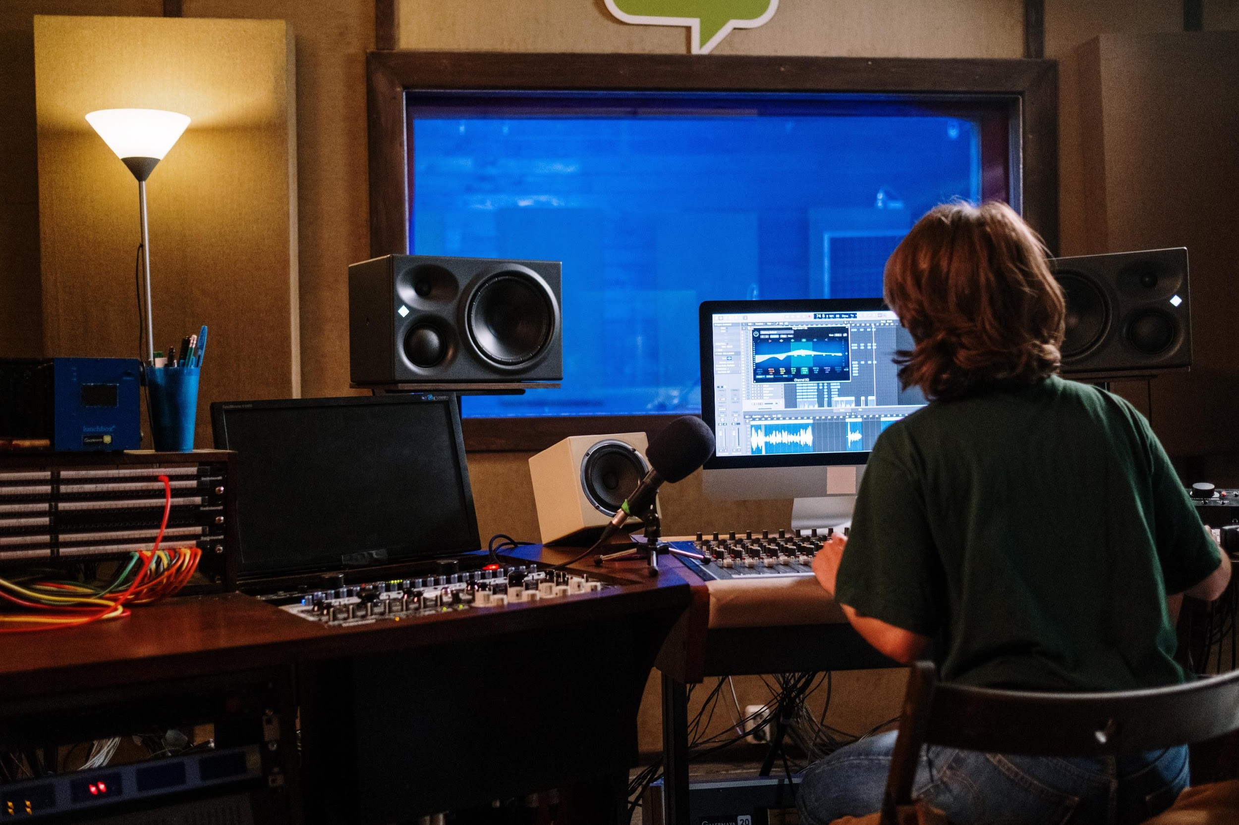
Your logo here
Beat Maker,
Music Producer
Rich MP3 files
High Quality

Slide 22
Your logo here
Professional content writing
Unique
Content
Fast
Delivery
SEO
Optimized
Researched
Content

Slide 23
Your logo here
Professional translations
Your image here
Username: XYZ

Slide 24
Your logo here
Proofreading
& Editing
A picture's worth 1000
words, but the right
words sell 1000
pictures!
Go relax & let me
Write it for you

Slide 25
Created by Tanischa96

Slide 26
SEO EXPERT
SEO EXPERT

Slide 27
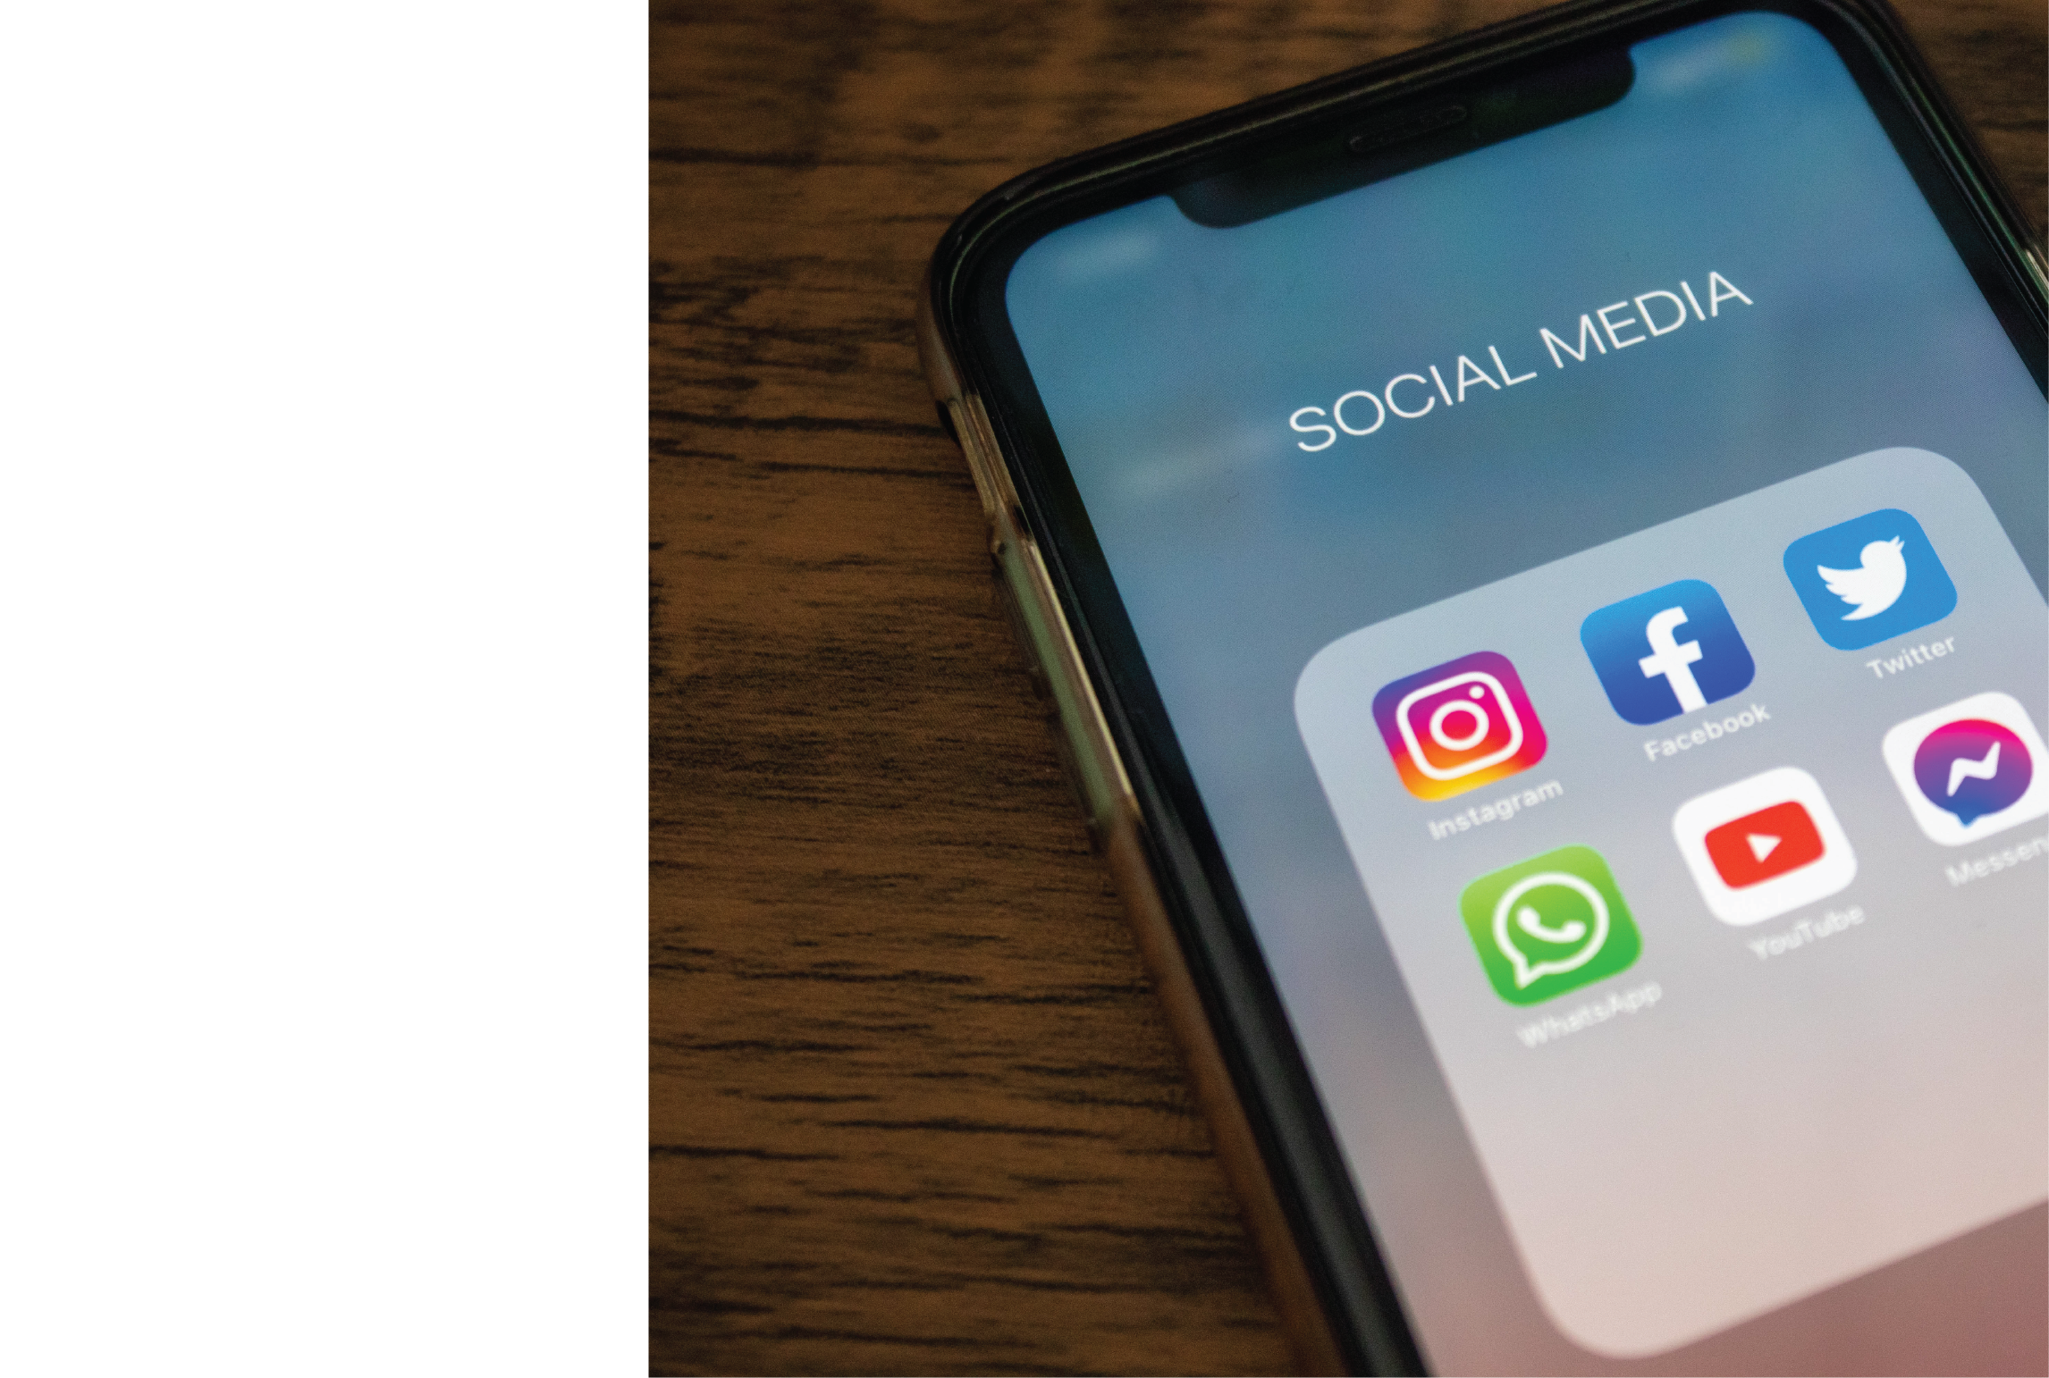
SOCIAL MEDIA
ADVERTISER
Your logo here

Slide 28
Voice
Over
Artist
Voice
Over
Artist
Irish Male
Your logo here

Slide 29
Mixing and Mastering Engineer
Your logo here

Slide 30
Music producer Music producer Music producer Music producer Music producer Music producer Music producer Music producer Music producer Music producer Music producer Music producer Music producer Music producer
CUSTOM BEATS
CUSTOM BEATS
Music producer Music producer Music producer Music producer Music producer Music producer Music producer Music producer Music producer Music producer Music producer Music producer Music producer Music producer

Slide 31
SEM Specialist
Your logo here

Slide 32
Professional
Content Writing
Your logo here

Slide 33
Translate:
French
English
Traductions professionnelles
Professional
Translations

Slide 34
Your logo here
Proofreading & Editing

Slide 35
Created by Digital_nomadet

Slide 36
English <> Spanish
Translations

Slide 37
A B C D E F G H I J K L M N O P Q R S T U V W X Y Z A B C D E F G H I J K L M N O P Q R S T U V W X Y Z A B C D E F G H I J K L M N O P Q R S T U V W X Y Z A B C D E F G H I J K L M N O P Q R S T U V W X Y Z A B C D E F G H I J K L M N O P Q R S T U V W X Y Z A B C D E F G H I J K L M N O P Q R S T U V W X Y Z A B C D E F G H I J K L M N O P Q R S T U V W X Y Z A B C D E F G H I J K L M N O P Q R S T U V W X Y Z A B C D E F G H I J K L M N O P Q R S T U V W X Y Z A B C D E F G H I J K L M N O P Q R S T U V W X Y Z A B C D E F G H I J K L M N O P Q R S T U V W X Y Z A B C D E F G H I J K L M N O P Q R S T U V W X Y Z A B C D E F G H I J K L M N O P Q R S T U V W X Y Z A B C D E F G H I J K L M N O P Q R S T U V W X Y Z A B C D E F G H I J K L M N O P Q R S T U V W X Y Z A B C D E F G H I J K L M N O P Q R S T U V W X Y Z A B C D E F G H I J K L M N O P Q R S T U V W X Y Z A B C D E F G H I J K L M N O P Q R S T U V W X Y Z A B C D E F G H I J K L M N O P Q R S T U V W X Y Z A B C D E F G H I J K L M N O P Q R S T U V W X Y Z A B C D E F G H I J K L M N O P Q R S T U V W X Y Z A B C D E F G H I J K L M N O P Q R S T U V W X Y Z A B C D E F G H I J K L M N O P Q R S T U V W X Y Z A B C D E F G H I J K L M N O P Q R S T U V W X Y Z A B C D E F G H I J K L M N O P Q R S T U V W X Y Z A B C D E F G H I J K L M N O P Q R S T U V W X Y Z A B C D E F G H I J K L M N O P Q R S T U V W X Y Z A B C D E F G H I J K L M N O P Q R S T U V W X Y Z A B C D E F G H I J K L M N O P Q R S T U V W X Y Z A B C D E F G H I J K L M N O P Q R S T U V W X Y Z A B C D E F G H I J K L M N O P Q R S T U V W X Y Z A B C D E F G H I J K L M N O P Q R S T U V W X Y Z A B C D E F G H I J K L M N O P Q R S T U V W X Y Z A B C D E F G H I J K L M N O P Q R S T U V W X Y Z A B C D E F G H I J K L M N O P Q R S T U V W X Y Z A B C D E I
Your logo here
Professional
Content Writing
Fast Delivery
Native English
5 Years Experience

Slide 38
Your logo here
Grammar and Syntax
Review

Slide 39
Your logo here
Rank Higher in SERP
Keyword research
Website Audit
Page optimization
On page SEO services

Slide 40
Social Media Ads
Done Right
Setup ● Management ● Optimization

Slide 41
Search
Engine
Marketing
Google Ads done By Experts

Slide 42
Your logo here
British English
Voice Over Artist

Slide 43
Expert
Beat Maker

Slide 44
Tailor-Made
Mixing &
Mastering
Your logo here

Slide 45
Created by Claudiofolha

Slide 46
Your image here
Articles & Blog Posts
Engaging Copy
SEO Friendly Content
Professional Writing

Slide 47
Your image here
Mixing & Mastering

Slide 48
Profreading
Proofreading & Editing
Your image here
Error Free Copy
Grammar Review
Fact Checking

Slide 49
Your image here
What you get?
Engaging Copy
SEO Friendly Content
Professional Writing
I Will Optimize Your Website

Slide 50
Ad
Your image here
Social Media Advertising
Engaging Copy
SEO Friendly Content
Professional Writing
Ad

Slide 51
Your image here
English Male Voice Over
Professional Voice Actor

